Slide 1

TEMPLE TICKETING SYSTEM
DevDwaar
TEAM MEMBERS:-
ADARSH SINGH
ARYAN SHARMA
SAURABH PAL
SHUBH TIWARI

Slide 2

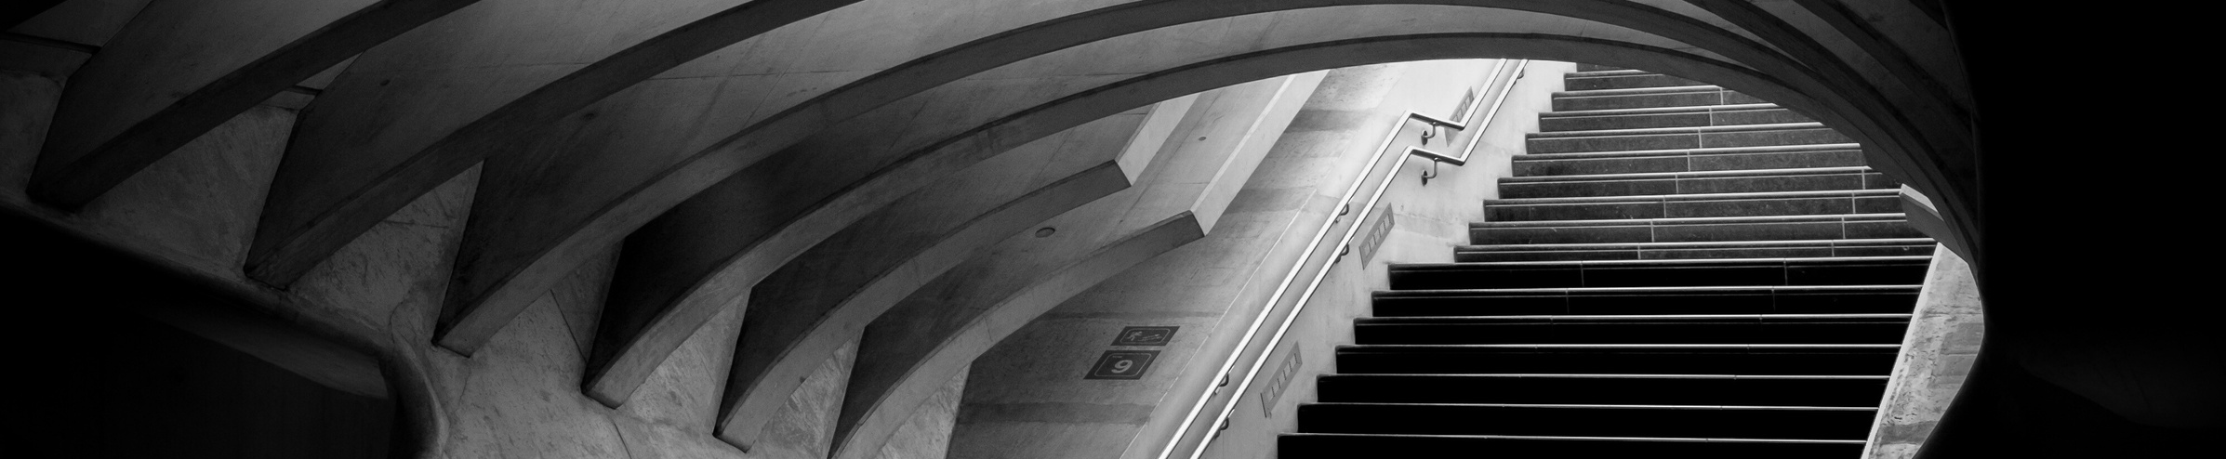
Features
 | Ticket QR code generation
 | Responsive Design
 | User Dashboard
User Registration/Login
Booking and Reservation
User Profile Management

Slide 3

Our Vision
Our vision is to revolutionize the way people experience events, travel, and services by providing a seamless and intuitive ticket booking platform

Slide 4







Goal # 1
Our Goals
Streamline Booking Process
Implement user-friendly interfaces and intuitive navigation to simplify the booking process, reducing the time and effort required for users to make reservations.
Goal # 2
Optimize Capacity Management
Goal # 3
Prioritize Safety Measures:

Slide 5









Tech Stack
These are the tech stack used in developing this project

Slide 6
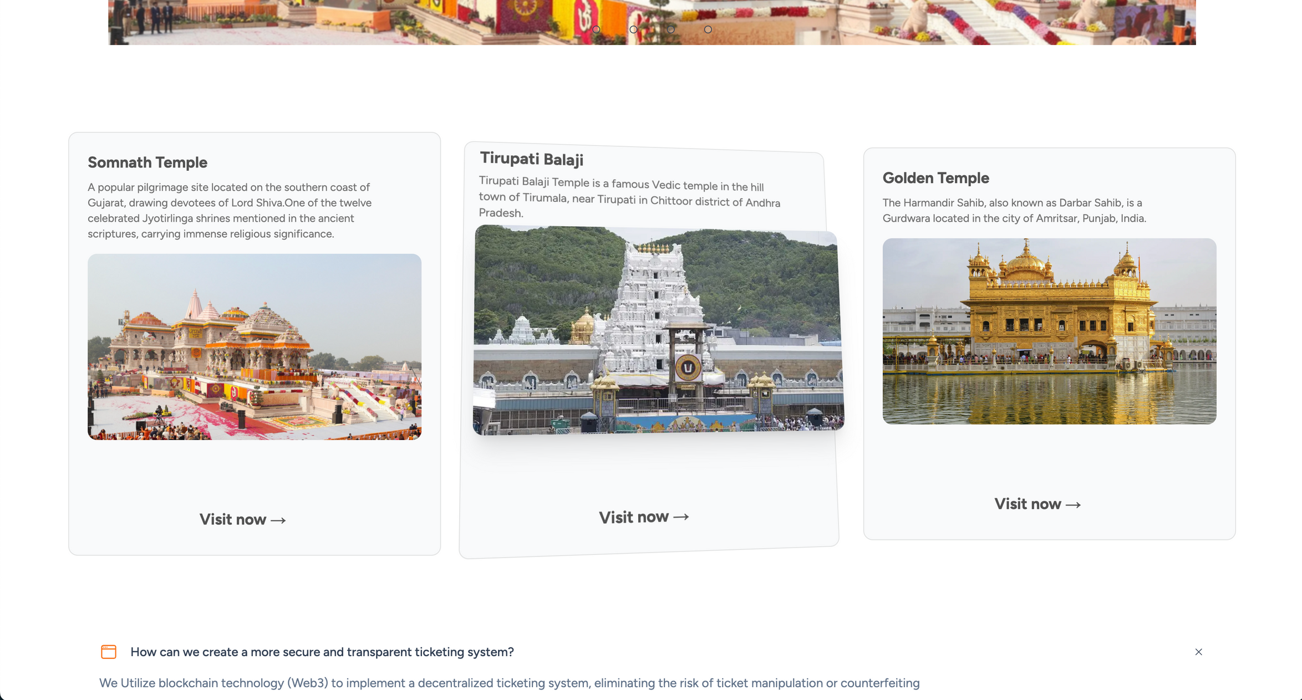
Navigate through DevDwaar

Slide 7
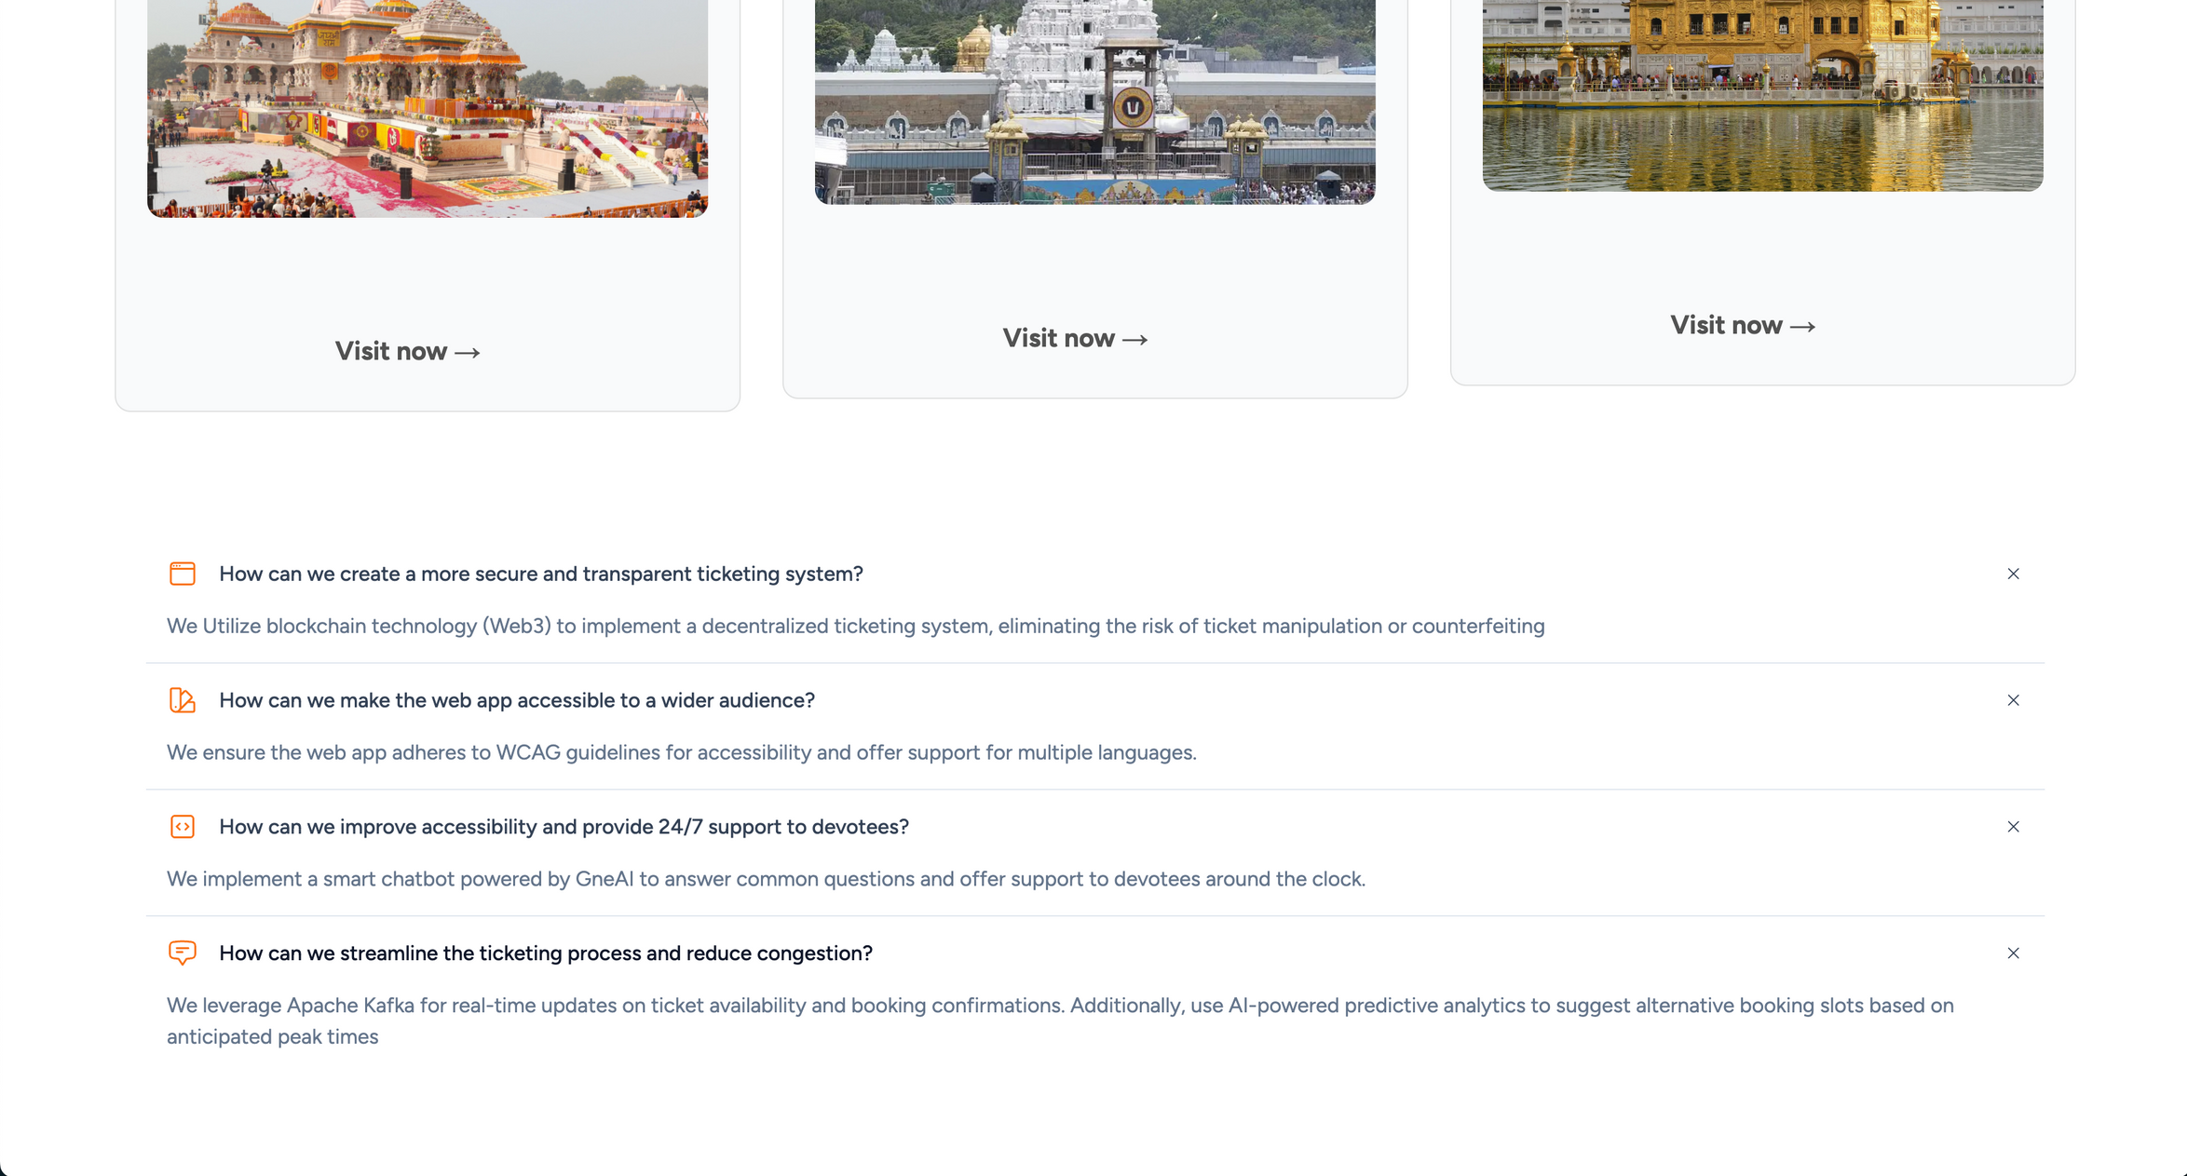

Slide 8
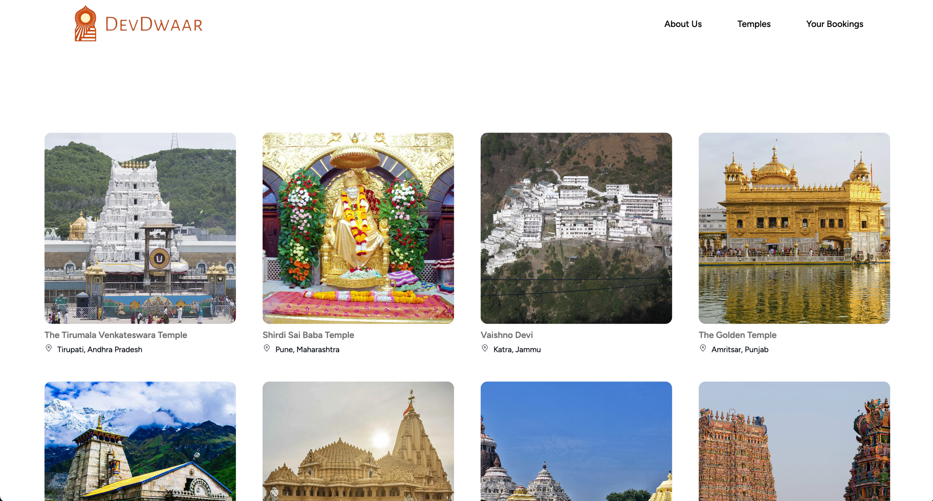

Slide 9
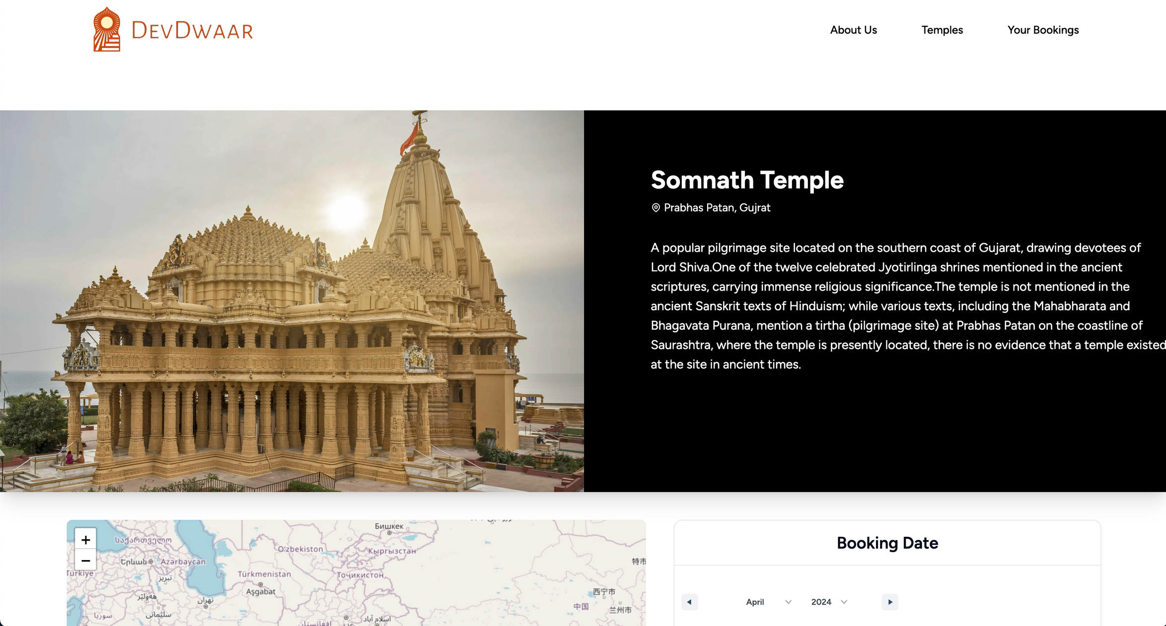

Slide 10
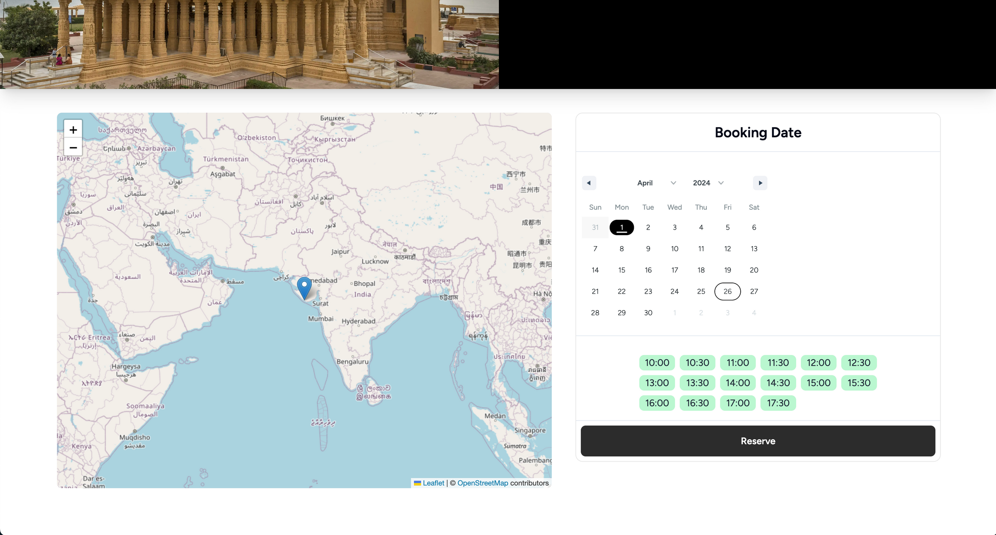

Slide 11
